Slide 1



Course Title : Graphically-Driven Project Planning and Design
Code: PROG1180
Week: 6
Term: Winter 2025
niagaracollegetoronto.ca

Slide 2

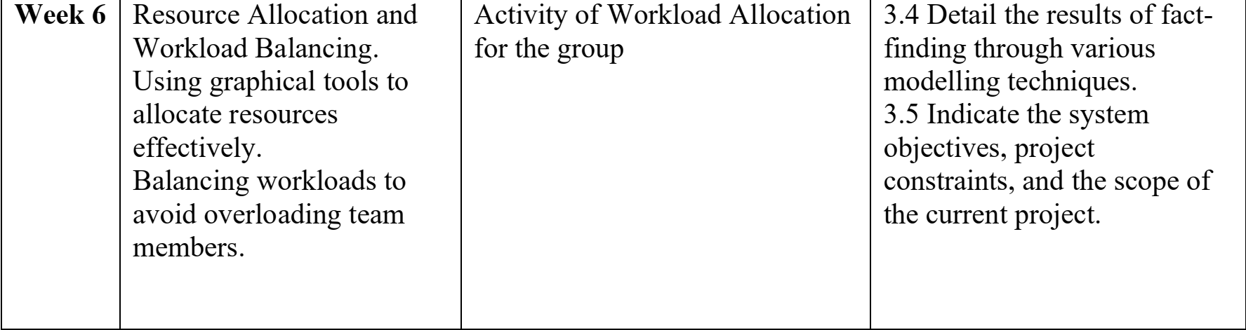
AGENDA

Slide 3
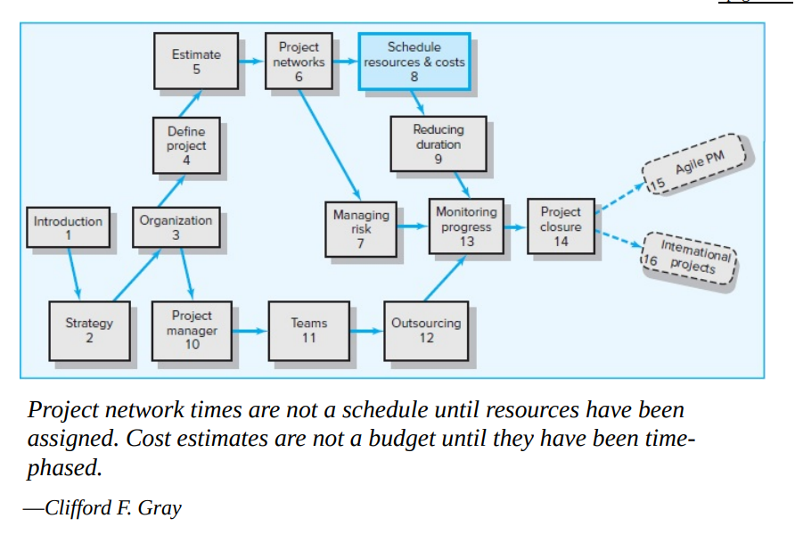

Slide 4
What Is Resource Management?
Resource management is the practice of planning, scheduling, and allocating people, money, and technology to a project or program. In essence, it is the process of allocating resources to achieve the greatest organizational value. Good resource management results in the right resources being available at the right time for the right work.
Regardless of work methodology, leaders seeking to practice effective resource management must balance demand with capacity while also understanding the needs of the business to prioritize, plan, and schedule work with the right teams, people, and skill sets.

Slide 5
Why Is Resource Management Important?
Planning and scheduling – Understanding what resources are available and when
Available and required skills – Assessing the skills of each person and whether additional skills (or people) need to be added
Resource utilization – Knowing where people are already committed and if those allocations are appropriate
Resource capacity – Understanding true capacity to do work, recognizing that not all time can be utilized
Resource prioritization and allocation – Identifying those prioritized initiatives that the most attention and possibly specialized skills

Slide 6
Viewing Resource Allocations
First, let’s turn to how team members can view their work and resource allocation.
As a team member, you can login to Project Insight and hover on the My Insight menu option and click Home Screen.
The Home Screen is a very popular form that a lot of team members use.
Right from this form, you can see how many tasks you are assigned to, how many issues, to dos, approvals and so on.
Click on Work List to see a consolidated list of everything assigned to you, including tasks, issues, to dos and more.
That is one way to see all your work. It is also a best practice for each team member to be aware of your work assignments but also your allocation.

Slide 7
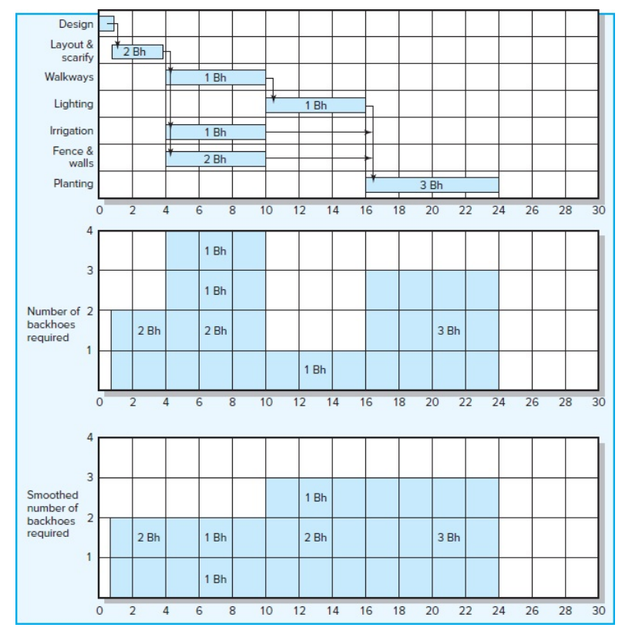
Time-constrained project
For the purpose of demonstration, the Botanical Garden project uses only one resource (backhoes); all backhoes are interchangeable. The top bar chart shows the activities on a timescale. The dependencies are shown with the vertical connecting arrows. The horizontal arrows following activities represent activity slack (for example, irrigation requires six days to complete and has six days of slack). The number of backhoes needed for each task is shown in the shaded activity duration block (rectangle). After the land has been scarified and the plan laid out, work can begin on the walkways, irrigation, and fencing and retaining walls simultaneously. The middle chart shows the resource profile for the backhoes. For periods 4 through 10, four backhoes are needed

Slide 8
What Is Workload Management?
Workload management is the process of assigning tasks to keep individuals and teams working at maximum efficiency. The workload management process involves planning, scheduling, distributing and monitoring workload to ensure teams achieve their goals while making sure work is evenly distributed among team members.
Workload Distribution & Scheduling
Once you’ve determined what your team’s workload will look like in the future, it’s important to use project management tools such as Gantt charts, kanban boards or project calendars to assign tasks to your team members depending on their skills and your overall resource availability.
Workload Monitoring
Planning and scheduling tasks are as important as keeping track of them to make sure they’ve been completed on time and under budget. To do so, you should use workload management software with features like dashboards and reports. To manage your team’s workload, you’ll need to create a workload plan which entails understanding your resources and the business priorities or tasks to be completed.

Slide 9
Assessing Resource Allocation
One of the strengths of project management software is the ability to identify and provide options for resolving resource allocation problems. One project manager who uses MS Project shared the following checklist for dealing with resource conflicts after preliminary assignment of resources.
1. Assess whether you have overallocation problems.
2. Identify where and when conflicts occur by examining the resource usage.
3. Resolve the problem by a. Replacing overallocated resources with appropriate resources that are available. Then ask if this solves the problem. If not: b. Use the leveling tool and choose the level within slack option. i. Does this solve the problem? (Are resources still overallocated?) ii. Check the sensitivity of the network and ask if this is acceptable.
If not: c. Consider splitting tasks. i. Make sure to readjust task durations to take into account additional start-up and shutdown time.
4. If 3 does not work, then either a. Use level tool default option and ask if you can live with the new completion date. If not: b. Negotiate for additional resources to complete the project. If not possible: c. Consider reducing project scope to meet deadline. While this checklist makes specific references to MS Project, the same steps can be used with most project management software.

Slide 10
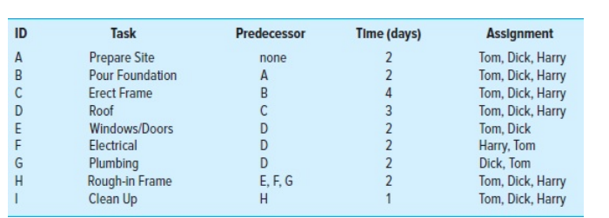
TASK
Jack and Jill Smith have just retired and want to build a small, basic cabin in the Blue Mountains of Vermont. They have hired Daryl Hannah as the general contractor for the project. She has assembled a team of three workers to complete the project: Tom, Dick, and Harry. Daryl has negotiated a cost-plus contract with the Smiths whereby she will receive 15 percent beyond the cost of labor and materials. Before they sign the contract the Smiths want an estimate of how much the project is likely to cost and how long it will take. Daryl has estimated that the cost for materials, permits, etc., will total $40,000. She wants to determine labor costs as well as how long the project will take. This is one of several projects Daryl is managing, and other than occasionally helping out, her role is strictly limited to supervising. She has devised the following master plan and assignments. Note that Dick is the only skilled plumber in the group, while Harry is the only skilled electrician. Tom is a general carpenter and can assist them with their work. Dick and Harry each get paid $300 a day, while Tom gets paid $200 per day. Daryl has negotiated a 10 percent management reserve to deal with unexpected problems. Unused funds will be returned to the Smiths.

Slide 11
Manage Workload With ProjectManager
1. Map Out Your Workload Plan
With ProjectManager, you can use multiple planning tools to balance the workload across your team and map out their work schedule. With our Gantt charts, kanban boards, project calendars and workload charts you can map out your tasks in phases and assign them to team members. The assignee’s name appears next to the task so you can view who is working on what.
2. Create Workload Schedules
You can use the online Gantt chart to create detailed workload schedules that let you assign work to team members by simply dragging and dropping tasks on the timeline. Since it’s an online Gantt chart, all data updates in real time so the entire team sees their new tasks in an instant. Simply click on a task and assign it to certain team members. You can add a number of team members or simply yourself if needed. Team members are even organized by department so you can quickly identify the best person for the job.
3. Monitor Workload Capacity
ProjectManager’s workload chart lets you see the number of assigned work hours to each team member to monitor your team’s performance and control heavy workloads. The box is green if the team member has a good number of hours; it’s orange if they are over or under-assigned. In the same view, you can click the box and instantly reassign tasks to adjust the workload.

Slide 12
4. Track Workload Costs With Timesheets and Reports
Use ProjectManager’s timesheets to keep track of labor costs as you assign work to your team. They sync automatically whenever you make changes to your workload plan from the Gantt chart, kanban boards and other task management tools.
5. Communicate With Team Members
If you’re going to change an assignment in your workload management system, don’t forget to speak to the people involved first. You can explain that you’re reallocating resources to balance the work and that it isn’t a reflection of their performance. In fact, as a result of your workload planning, they may end up with a better work schedule. Communicating with your team is key to success, so you’ll also need effective team collaboration tools. Talk to them about upcoming holidays and include those in your workload planning so you don’t assign them tasks while they’re away.

Slide 13
Key challenges
Key challenges associated with resource management that you might face and that software can address include:
Managing and prioritizing project work requests and setting appropriate expectations with key stakeholders
Managing resource capacity versus demand for that capacity and understanding who is available to take on new work and when
Understanding what roles and / or skill sets are needed, either internally or through new hires, in order to fulfill stakeholder commitments
Ensuring that available resources are working on the highest priority projects that are best aligned with the strategic goals of the organization
Optimizing scheduling for when the appropriate resources are available to work on projects

Slide 14
Case study: Facing multiple challenges
A company that sells children’s apparel worldwide through a multiple-channel business model made it a strategic and operational priority to revamp its IT project and resource management efforts to continue business growth.
IT had multiple project lists maintained separately by various business units, with no governance in how to select or create projects or tracking of project costs or resource requirements. This made regulatory compliance virtually impossible.
Managers and IT resources had no way to identify which projects were the most valuable for the company. This created associated resource management issues; since IT staff was being expensed on software projects that depreciated over multiple years, there was a mismatch of project costs, and auditors were concerned about improper annual expenses.
Furthermore, each workgroup within the company had a different set of “run the business activities,” creating more than 100 different activity types. There was no way to determine how IT personnel were actually spending their time.
In addition, several groups were involved in almost every project with minimal coordination between projects. It was impossible to forecast resource capacity issues, and this created constant resource conflict issues.
The organization deployed a resource management solution to address its multiple challenges and support business growth. The solution provides a simple workflow and project structure that was missing, and the company can now define project tiers to establish priorities.
The use of comprehensive time tracking enforces standard rate roles for all project members, based on salary ranges. All IT project members are allocated to projects and tasks, all managers and users are trained on new activities, and new reports are created for managers and activities.
Due to improved processes and planning, the company has seen more than $2 million in capital savings and $2.6 million in expense savings.
Resource management enabled the company to improve the prioritization of work and resources with a six- to 12-month view of resource planning activities.

Slide 15
Case study: Lacking visibility into resources
A health insurance provider lacked an integrated view of demand and capacity and found it difficult to prioritize and communicate pipeline demand without restraining resources. The company wanted to improve the resource management, work management, investment planning, and reporting.
Governance was important, as was being able to forecast demand and capacity for accurate investment planning. With a half dozen internal delivery partners, the firm needed to look at how to best broaden its view to understand supply, demand, capacity, and systems.
The company deployed resource management software to balance demand from multiple sources and assign work to resources to ensure that they can complete the most valuable projects.
With the solution, the company can make the best use of its resources and focus on projects that align best with its strategic plan. The insurance firm now focuses on optimizing resource capacity, ensuring resources are tackling the right mix of work at the right time.
Previously, the company struggled with data in various spreadsheets. Resource management was nearly impossible in static documentation that was always seemingly out-of-date or incorrect. Using integrated investment and capacity planning capabilities, the company is confident that it can strategically staff teams to maximize value and productivity. It is distributing staff and resources based on project prioritization.
Granular reports give resource managers actual and forecast detail by portfolio and project and staffed / unstaffed work information so that they can identify resource gaps. Status detail at every level provides managers with the data they need to ensure capacity can meet demand now and 18 months in the future.

Slide 16
Using their configuration of resource management software, the firm can forecast demand 12 to 24 months ahead and use that information to allocate resources weekly. It is better defining roles, with more detail to provide greater insight into capacity and demand. Among the key benefits:
Optimized resources by focusing staff on efficiency and value
Prioritized work that aligns to roadmaps for better visibility
Maximized portfolio and staff productivity with the use of investment planning
Integrated plans to measure capacity and demand
Prioritized demand by capacity and role

Slide 17
SUMMARY
Resource Allocation and Workload Balancing.
Using graphical tools to allocate resources effectively.
Balancing workloads to avoid overloading team members.

Slide 18
References
https://www.projectmanager.com/blog/quick-guide-resource-management
https://www.saviom.com/blog/project-resource-management-an-ultimate-guide-on-how-to-master-it/

Slide 19
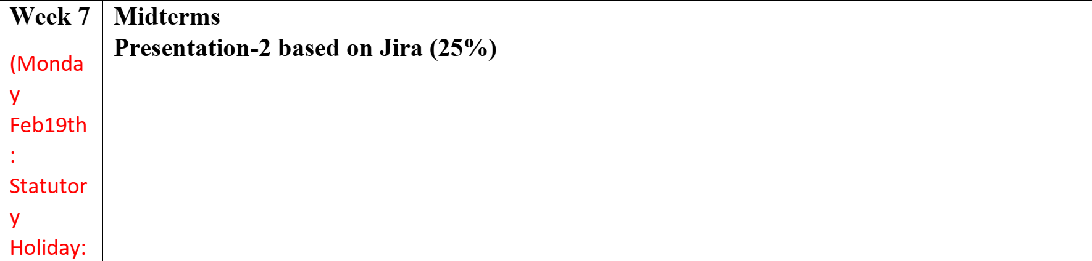
NEXT

Slide 20

Any Questions

